Slide 1

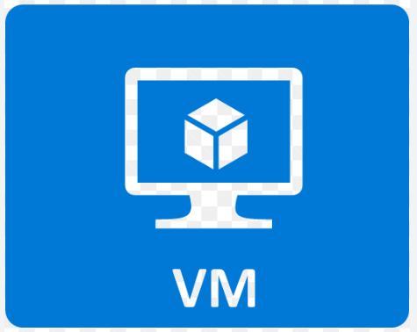


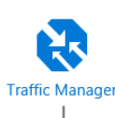



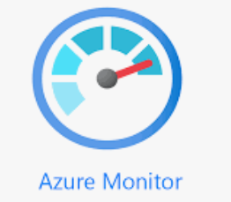
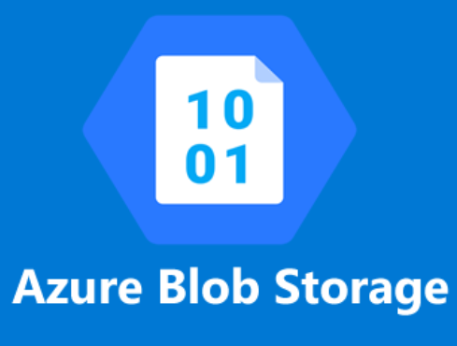
RG
Availability Set
Availability Set
WAF Enabled
DB1
Web VM1
App VM1
Data Replication
ILB1
ILB2
Web tier: The top layer including the user interface. This layer parses user interactions and passes the actions to next layer for processing.
App tier: Processes the user interactions and makes logical decisions about the next steps. This layer connects the web tier and the data tier.
Data tier: Stores the application data. Either a database, object storage, or file storage is typically used.
Web VM2
App VM1
DB2
Virtual Network 1
Backup & Restore
keyvault
Supporting Components

